Slide 1
Project Ragnarok:
Post-Quantum Cybersecurity with Lightning data
Milestone 1 Presentation
Team Members: Joanna Zhang, Gianni Bubb,
Aidan Nelappana
Faculty Advisor and Client: Dr. Bhattacharyya
Dr. Amitabh Nag

Slide 2
Goal Reintroduction
Project Thor: A web application that generates high-entropy encryption keys using lightning data as a natural source of randomness.
Goal: Extend Project Thor capabilities by adding new cryptographic algorithms, easier pulling of keys, and database security
Project Ragnarok through core system improvements, including API development, post-quantum algorithm implementation, entropy validation testing, and database security remediation

Slide 3
Technical Challenges
Working with Project Thor’s original website
  Key generation
  Connecting the database

Slide 4
Task 1: Technical tools
Python API frameworks
  FastAPI, web2py, flask and py4web
Notes:
Describe the tools

Slide 5
Compare and Select Collaboration tools
Github as the code repository
Google drive for sharing files
  Docs for writing collaboration
  Slides for presentation collaboration
Text message group chat, Discord server for general communication
Google Calendar for scheduling meetings

Slide 6
Task 2: Demos
API Frameworks
  Security Features
  Documentation quality
  Database connection
  Performance
Notes:
Introduce the demos and explain

Slide 7
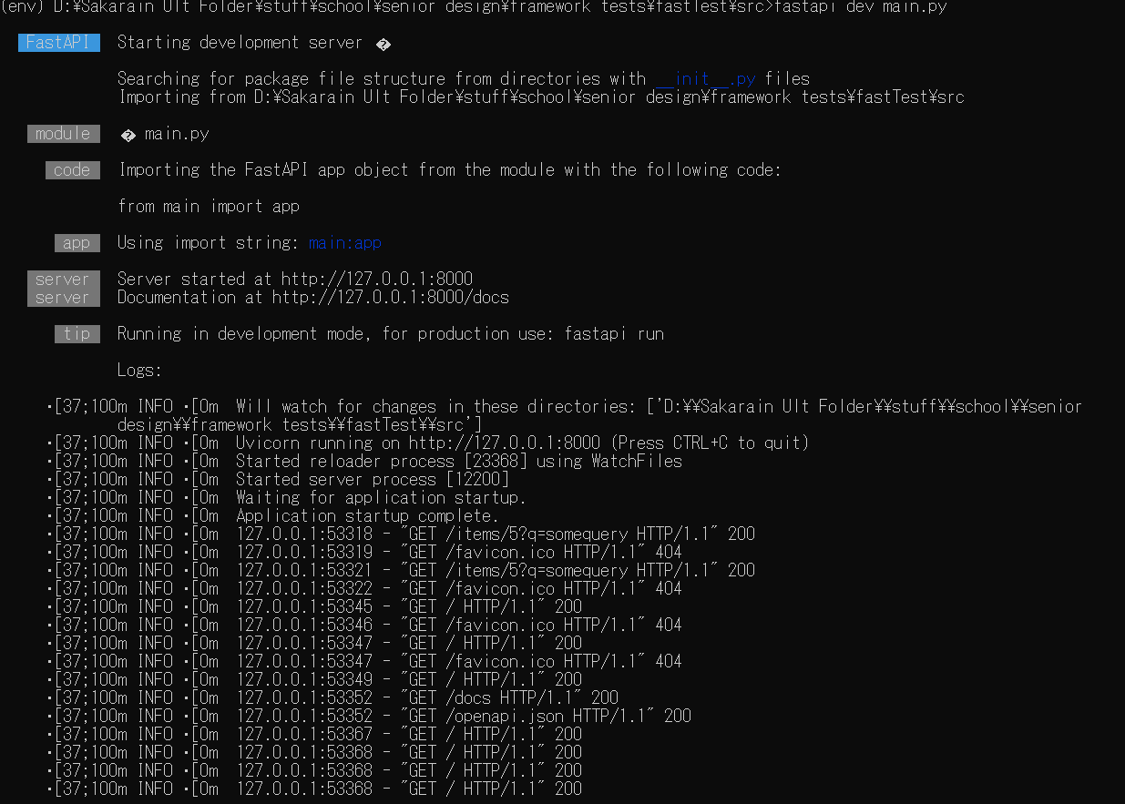
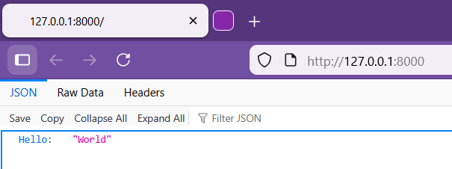
Demo 1: API Hello World via FastAPI
Notes:
Image on the left is the starting the server, which is locally hosted. Image on the right is the result of a get request at the root of site.

Slide 8
Task 3: Requirements
Specifies functional and non-functional requirements
Aligns team, advisor, and client expectations
Guides design, implementation, and testing
Prevents scope creep and misunderstandings
Serves as the foundation of the project

Slide 9
Task 4: Design
Describes how the system will be built
Defines system architecture and components
Explains data flow, APIs, and database structure
Details security mechanisms and technology choices
Serves as a blueprint for implementation

Slide 10
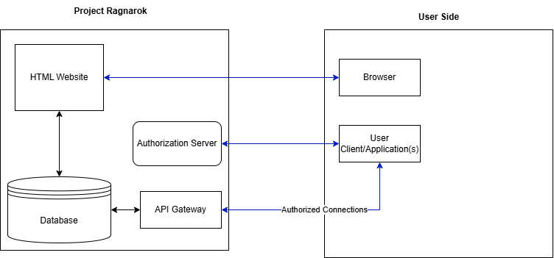
Design: System Architecture

Slide 11
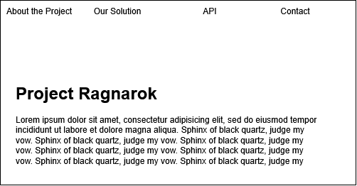
Website Layout: Landing Page

Slide 12
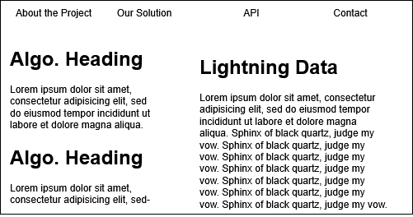
Website Layout: Solution Page

Slide 13
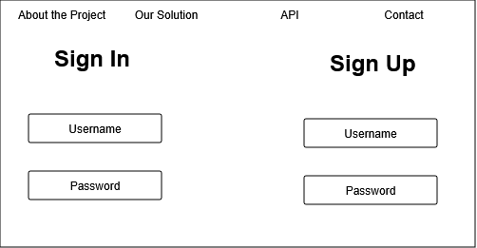
Website Layout: API sign in

Slide 14
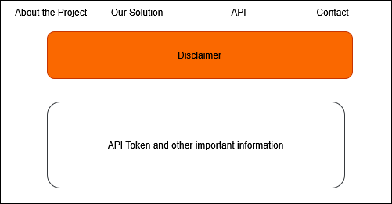
Website Layout: API token generation

Slide 15
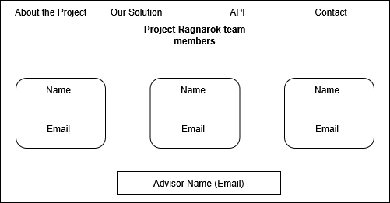
Website Layout: Contact Page

Slide 16
Task 5: Test
Defines how system requirements will be verified
Specifies test cases, inputs, and expected outputs
Ensures functionality, security, and performance validation
Identifies success criteria for each feature
Supports debugging and issue tracking
Confirms the system meets project requirements

Slide 17
Milestone 1 Task Matrix
Task | Task Description | Completion % | Joanna | Gianni | Aidan | To Do / Issues
1 | Investigate tools | 90% | 10% | 40% | 40% | Look into Project Thor
2 | Hello World demos | 30% | 0% | 15% | 15% | Adjust as the project is refined
3 | Requirements Document | 100% | 33% | 33% | 33% | Adjust as the project is refined
4 | Design Document | 100% | 33% | 33% | 33% | Adjust as the project is refined
5 | Test Plan | 100% | 50% | 50% | 0% | Adjust as the project is refined
6 | Implement, test & demo feature/module | 30% | 10% | 10% | 10% | Adjust as the project is refined

Slide 18
Milestone 2 Tasks Matrix
Task | Aidan | Gianni | Joanna
Implement basic Python API | Assist with backend integration | Lead API endpoint development and routing | Document API structure and update design/test docs
Implement basic Post-Quantum (PQ) algorithms | Lead implementation of selected PQ algorithms (NIST-aligned) | Assist integration with entropy module | Research standards and document security rationale
Database security remediation & fixes | Document remediation steps and update security design | Assist with backend security integration | Implement security controls and hardening

Slide 19
Thank you for your attention.

